Slide 1
CIND 820 Big Data Analytics Project Predicting the Popularity of Online News
By: Jaime Ip

Slide 2

Outline
Introduction
Research Questions
Milestones of this project
Q & A

Slide 3
Introduction
The theme of this capstone project is forecasting the popularity of online news based on a broad set of extracted features.

Slide 4
Research Questions
The relationship between the popularity and the features of article
Select the best model for predicting the popularity
Optimize performance of model by selecting the best set of features

Slide 5
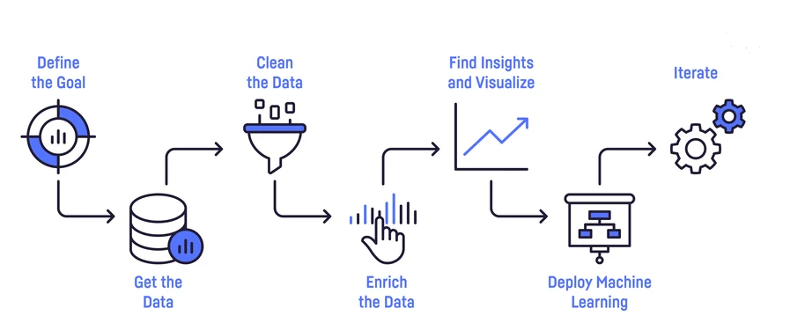
Project Milestones
Select topic
Define research
questions
Get the
Data
Feature Engineering
Stage 1
Data Collection
Stage 2
Data Preparation Data Exploration
Stage 3
Model Selection
Feature Selection

Slide 6
Stage 1 Data Collection
Choose topic and download dataset
Set up research questions
Programming language used : Python

Slide 7


Dataset
Online News Popularity Dataset from the UCI Machine Learning Repository
Originally acquired and pre-processed by K. Fernandes et al.
61 attributes of 39,644 articles published in Mashable website from 2013 to 2014

Slide 8


Stage 2 Data Preparation & Exploration
Address the 1st research question
Goal: Clean up data, identify characteristics of data and relationship between features and target variable, feature engineering

Slide 9
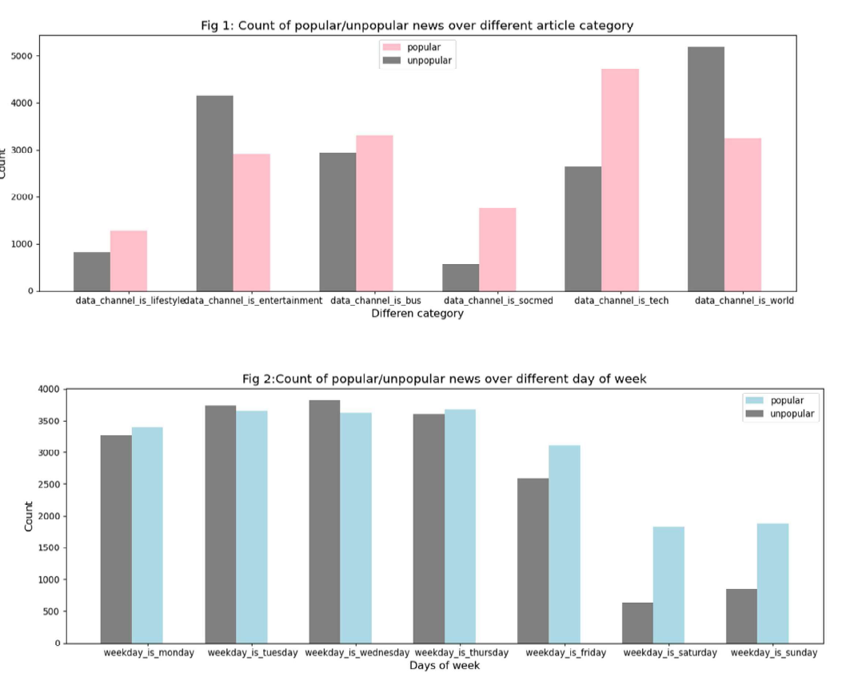
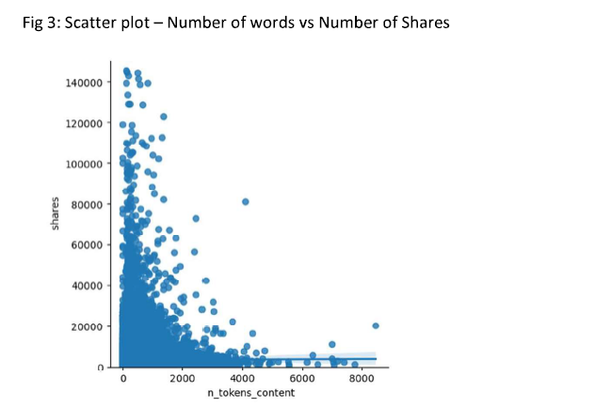

Slide 10
Stage 3 Model Selection & Feature Selection
Address the second and third research questions
Goal:
Split dataset into training and testing sets
Normalizing features - StandardScaler
Train models
4 round of testings + Feature Elimination
Tuning –Random Search Method

Slide 11
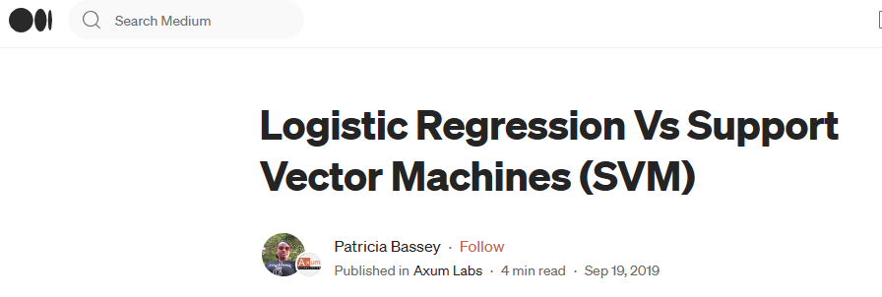
Selected Models
Random Forest - it is the best model in the original study
Logistic Regression – Another study pointed out it can achieve better accuracy than Random Forest
SVM – inspired by an article that compared Logistic regression and SVM in Medium.com

Slide 12
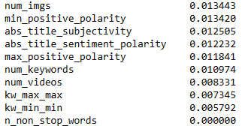
Testings + Feature Elimination
1st round : Use the full set of features in 3 models and identify the 10 least important features
2nd round : Remove the 10 least important features Result is similar to 1st round
3rd round: Revised the grouping of Shares Level Performance of models are improved
**Random Forest has the best results in all 3 rounds**

Slide 13
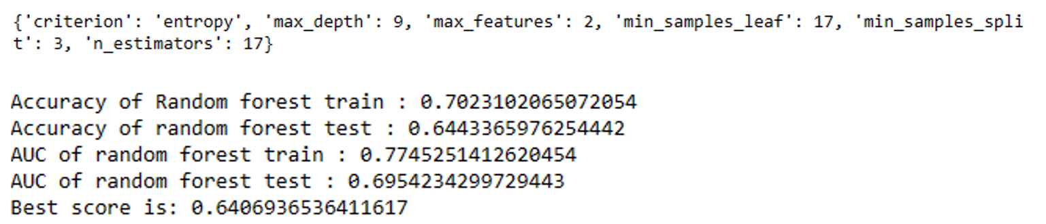
Optimize the performance
4th round :
Compare the 10 least importance ranking list ran by RFE and Pandas Series.
7 common features are removed and accuracy is improved
from 0.63 to 0.65
Tuning – Random Search Method
Best score is 0.64

Slide 14
Results
Random Forest is the best model
Selected least important features recognized by 2 methods are eliminated to improve efficiency and accuracy
Limitations
Classification approach – losing a level of details and possible misinterpretation
People’s interest continue to change. The result in this project may not applicable to articles published in earlier or later years.

Slide 15
Future Works
Other approach like multiple regression can be used to get more details
Predicting long term popularity evolution can improve the performance of the model

Slide 16


Slide 17
Thank you!

